Slide 1
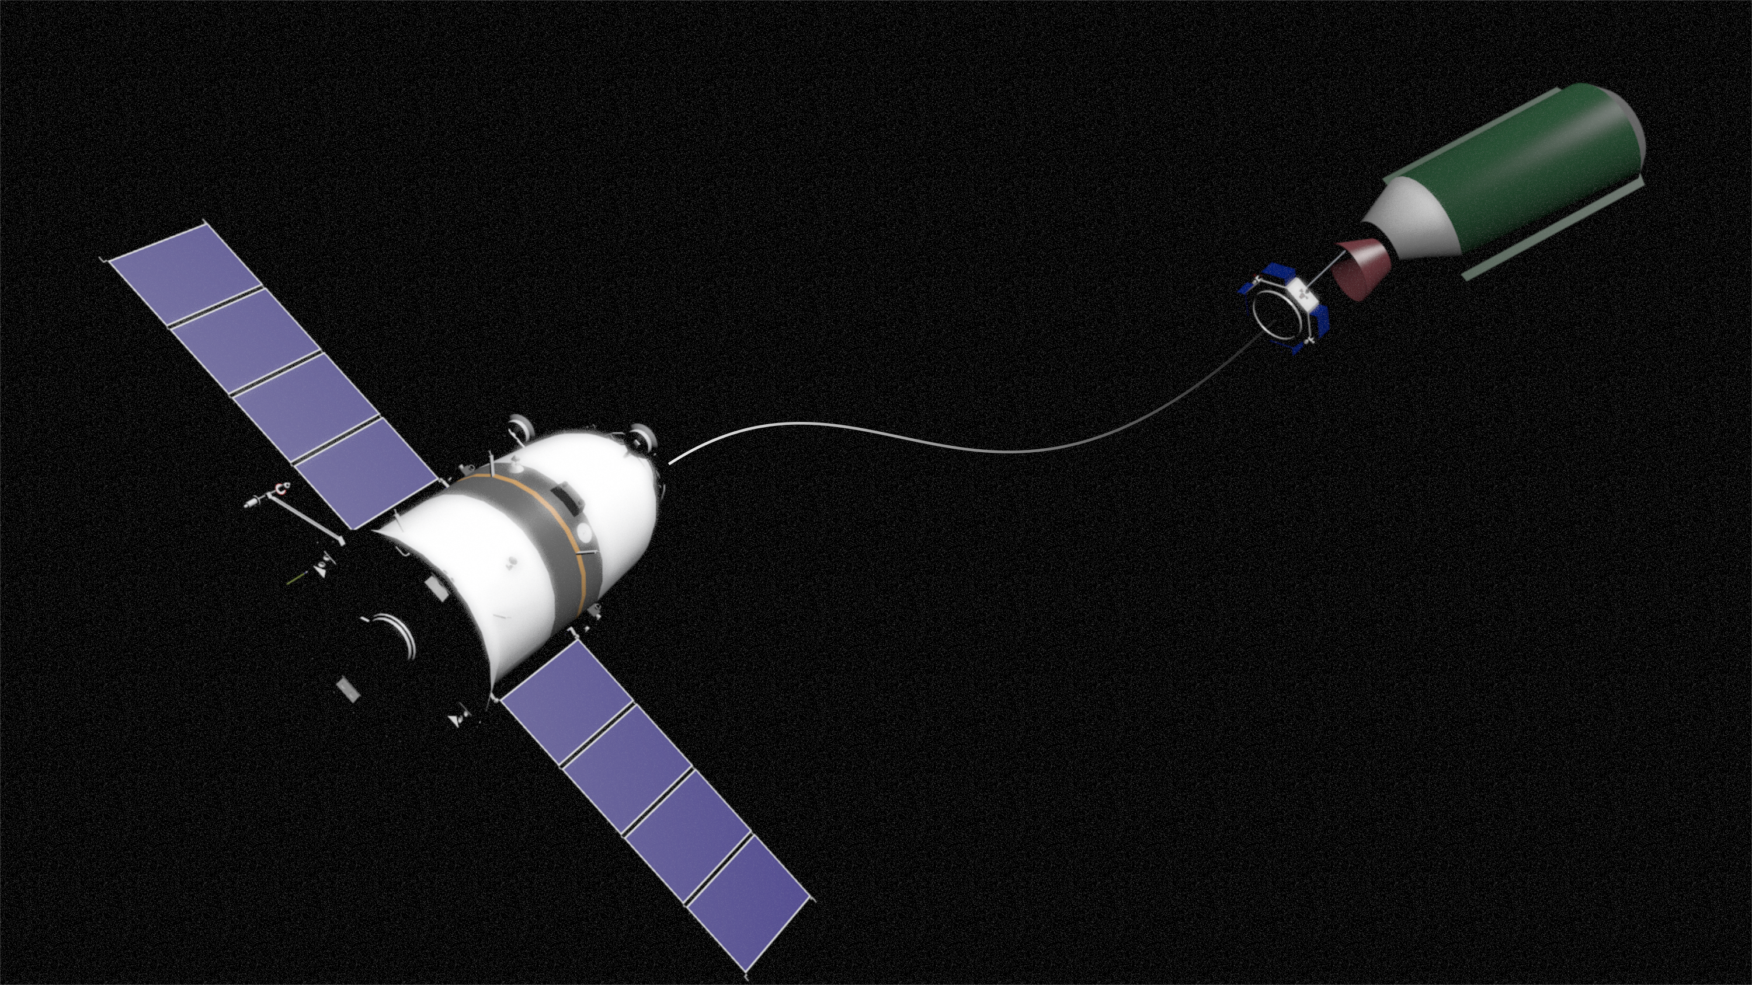

Method of Active Debris Removal Using Rotating Space Tether System
Valeriy I. Trushlyakov, Vadim V. Yudintsev
The First International Orbital Debris Conference (IOC)
December 9–12, 2019, Sugar Land, Texas.

Slide 2
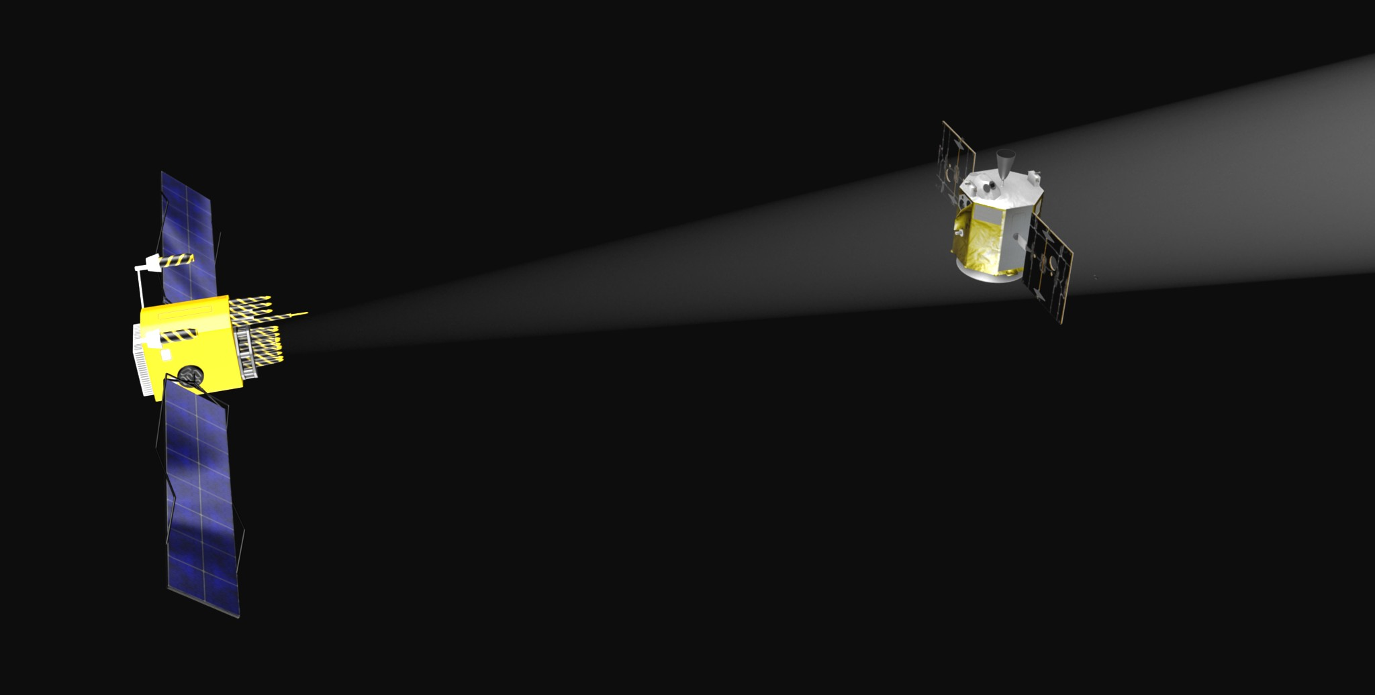
ADR methods with mechanical contact
Active Debris Removal methods with mechanical interaction between the space debris and space tug
Hard mechanical interface
Robotic manipulators, tentacles
Docking devices (probe-cone)
Soft mechanical interface
Net + tether
Harpoon + tether
Bonnal, C., Ruault, J.-M., & Desjean, M.-C. (2013). Active debris removal: Recent progress and current trends. Acta Astronautica, 85, 51–60.

Slide 3

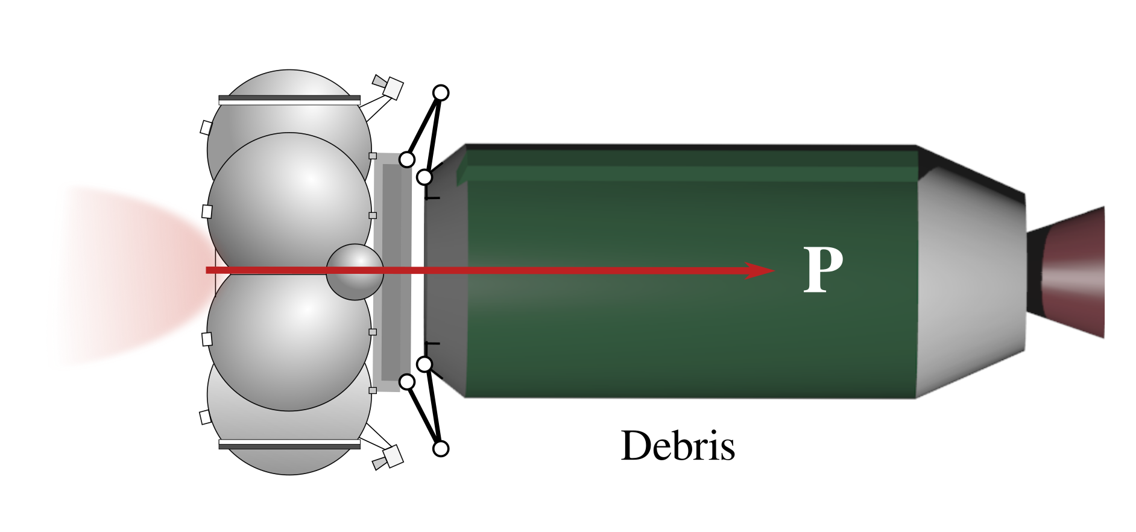
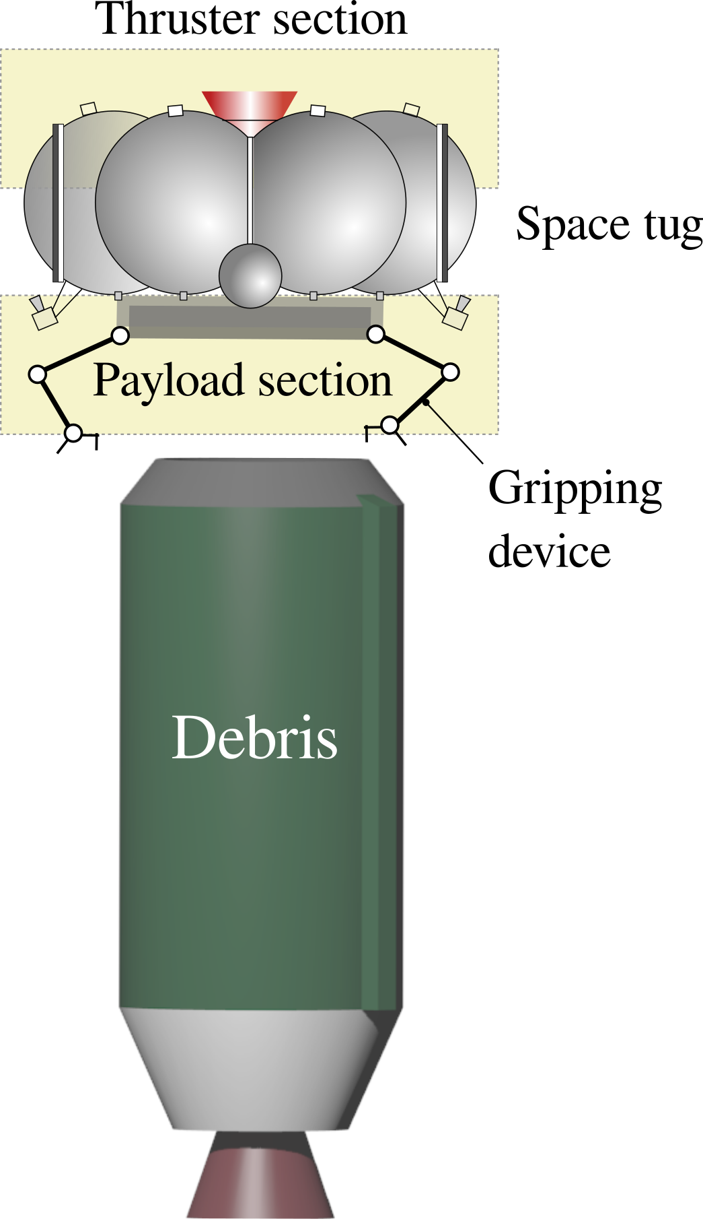

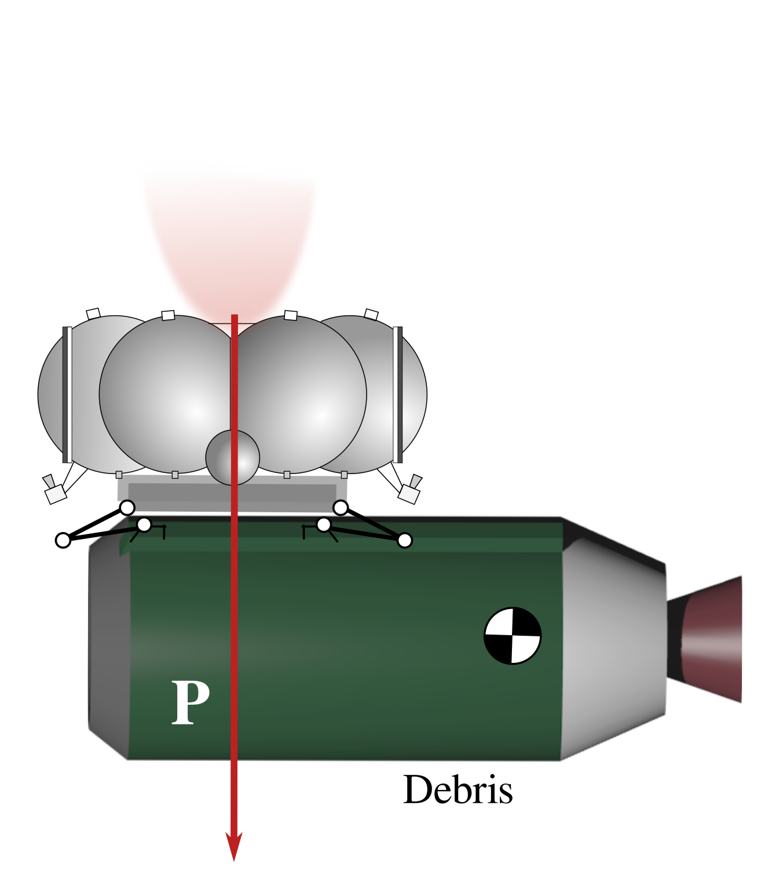
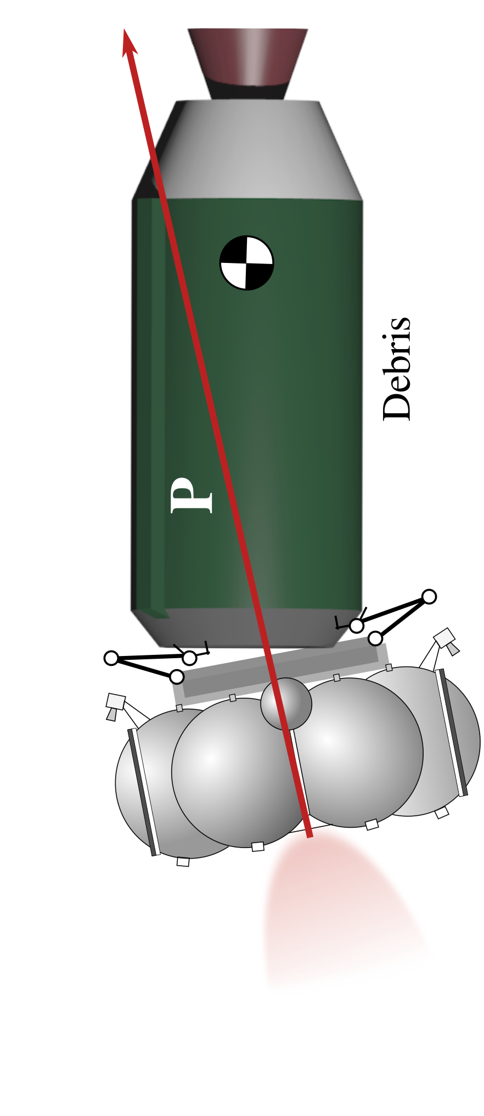
Hard mechanical interface
Robotic arm, probe-cone docking device
Space tug pushes the debris object
Stability of the system depends on the capture point and gripper type
The space tug with conventional design can be used

Slide 4
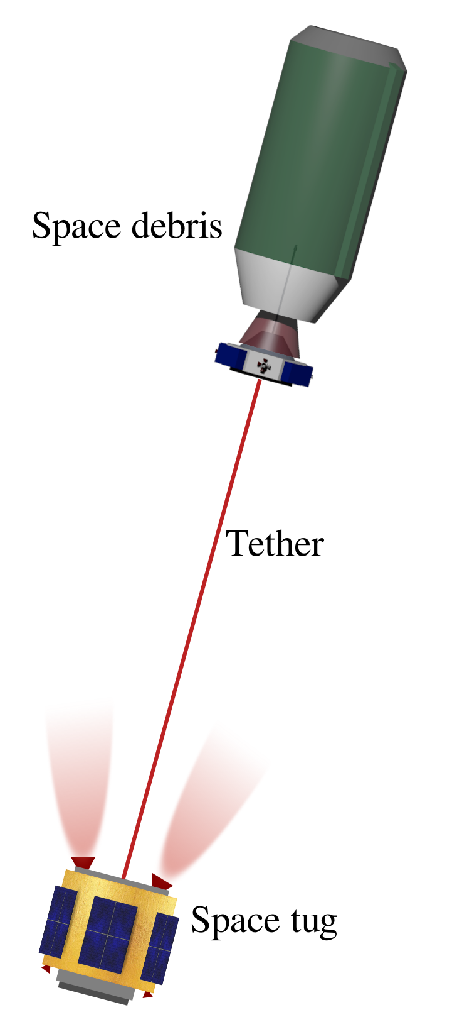
Soft mechanical interface
(Harpoon, net) + tether
Space tug pulls the debris object
Gripping process is safe for the space tug
Tumbling debris objects can be captured
Tether could be damaged by the tug’s thruster exhaust
Payload section and the thrusters are at the same side of the space tug -- design of the space tug is not conventional

Slide 5
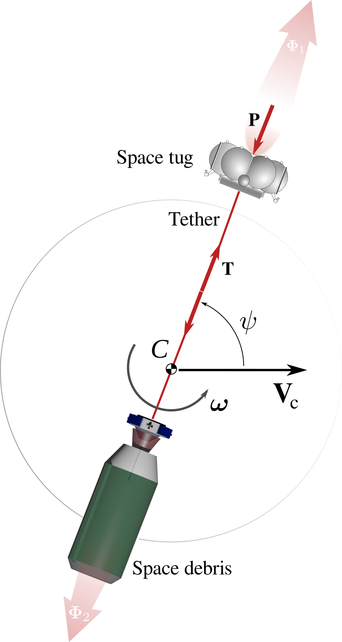

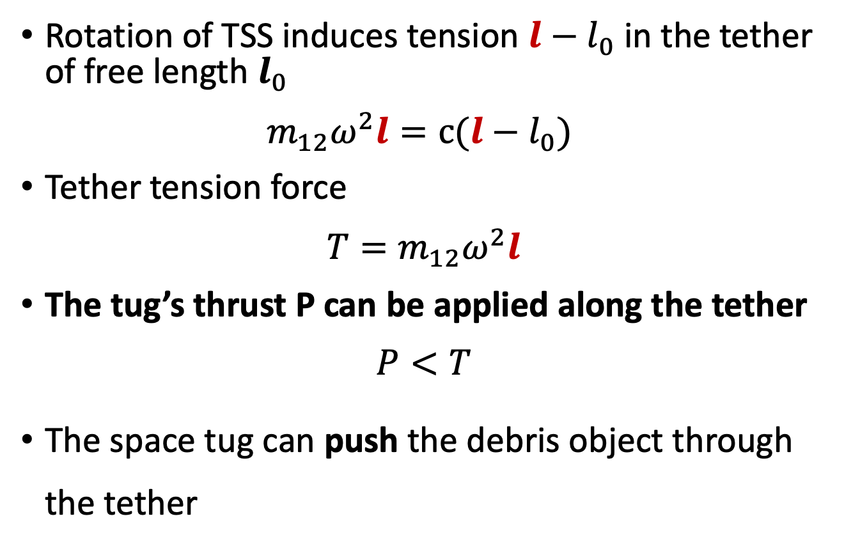
Rotating TSS
Rotation of TSS induces tension $l−l_{0}$in the tether of free length $l_{0}$
$$m_{12}ω^{2}l=с(l−l_{0})$$
Tether tension force
$$T=m_{12}ω^{2}l$$
The tug’s thrust P can be applied along the tether
$$P<T$$
The space tug can push the debris object through the tether

Slide 6
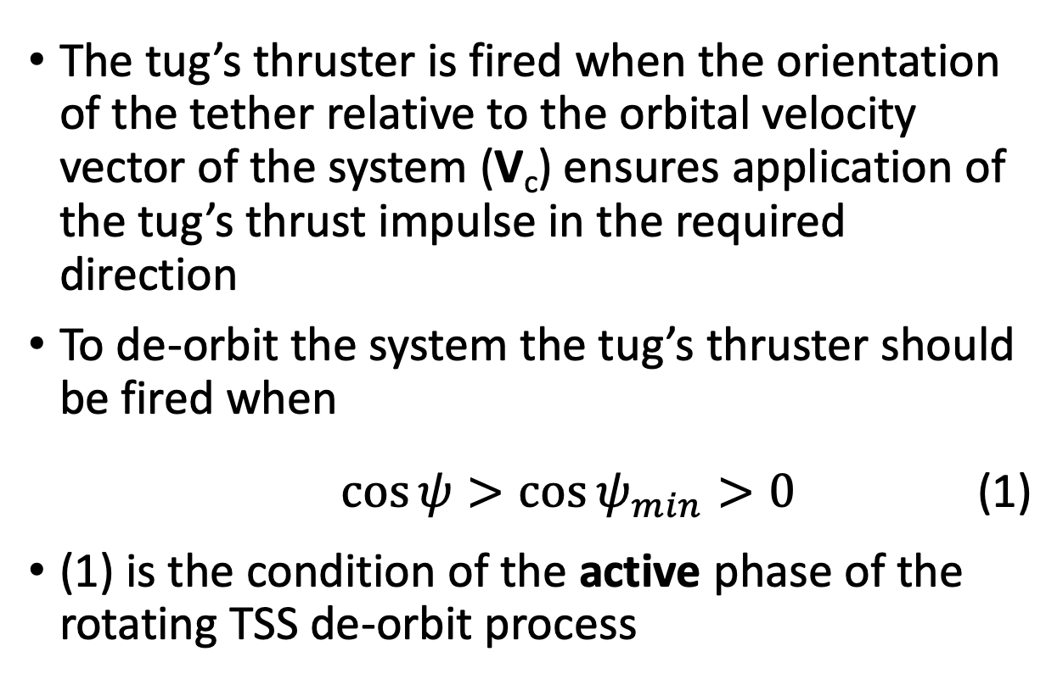
De-orbiting TSS
The tug’s thruster is fired when the orientation of the tether relative to the orbital velocity vector of the system (V_{c}) ensures application of the tug’s thrust impulse in the required direction
To de-orbit the system the tug’s thruster should be fired when
$\cos{ψ>\cos{ψ_{min}>0}}$ (1)
(1) is the condition of the active phase of the rotating TSS de-orbit process

Slide 7
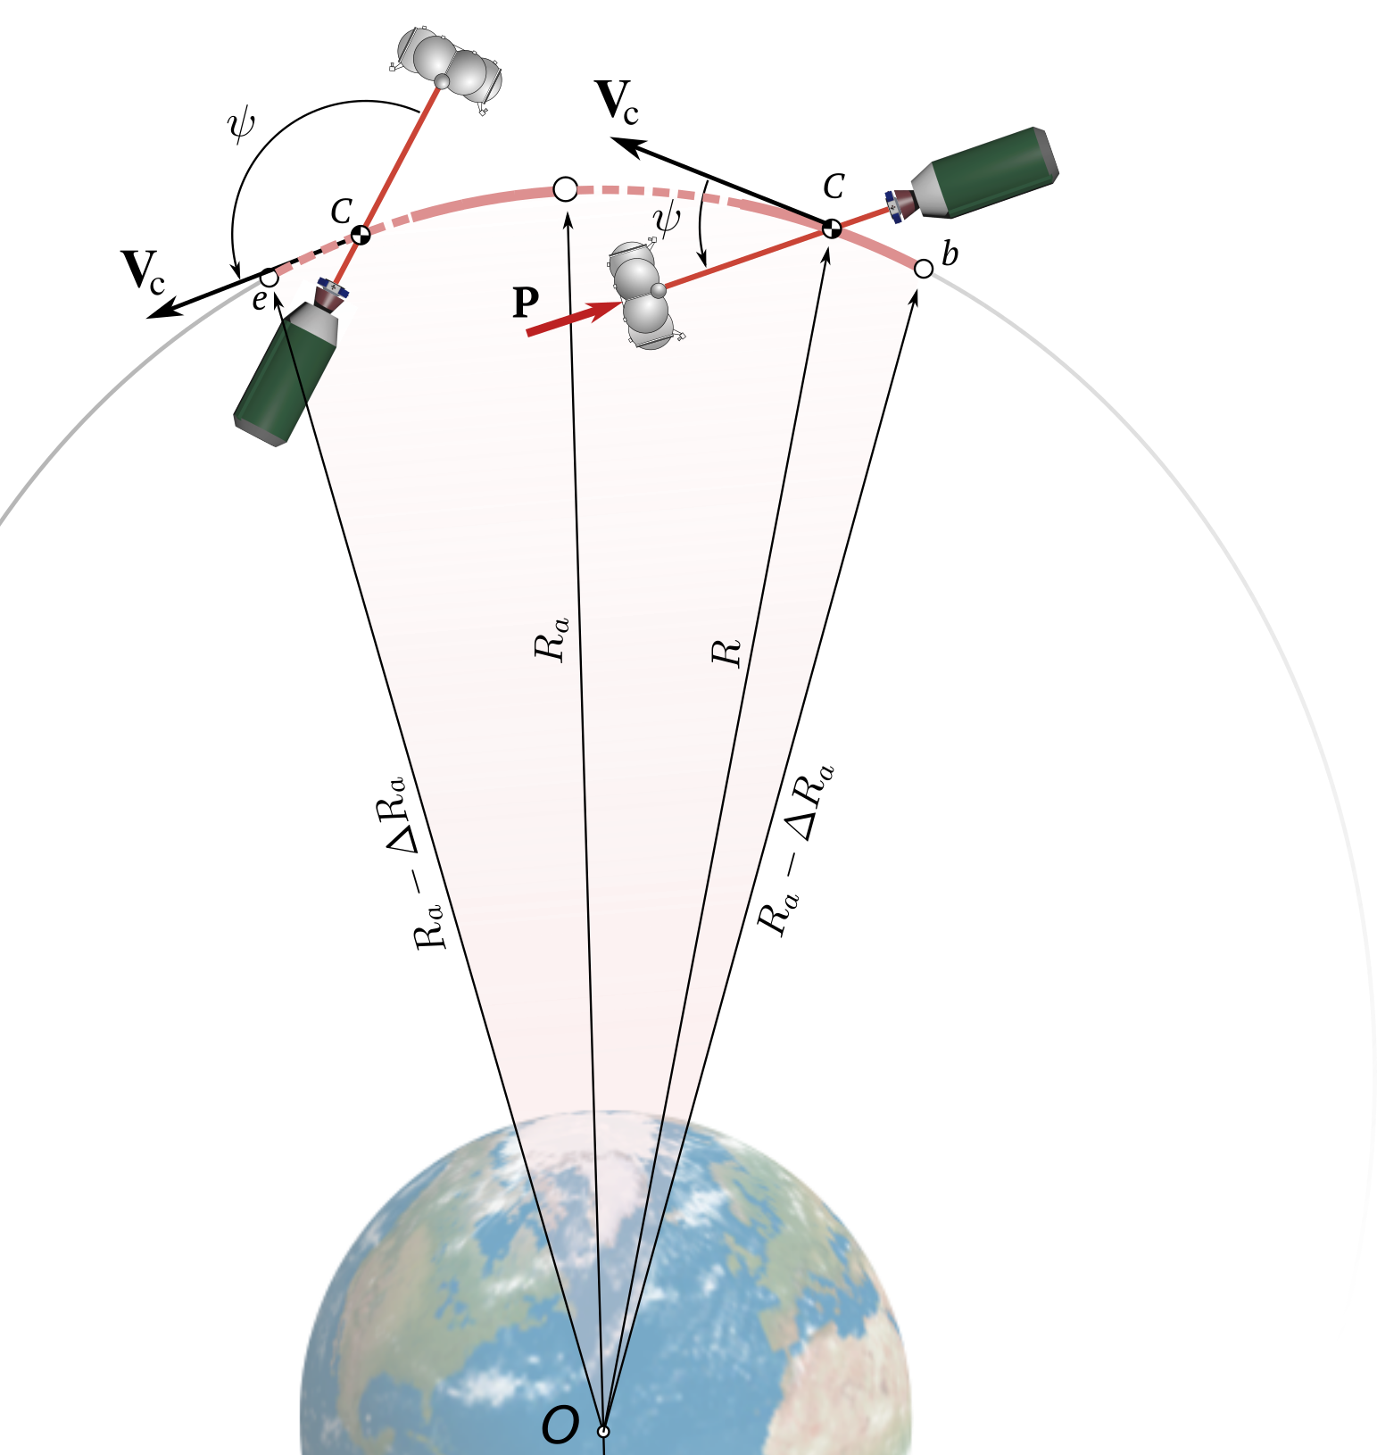
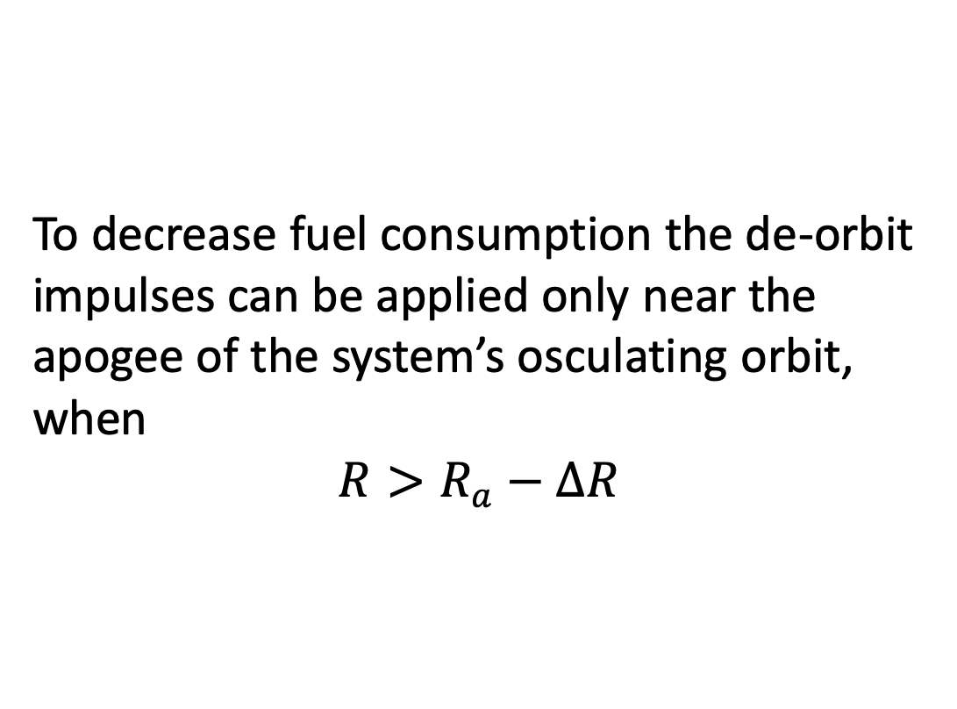
De-orbit of the TSS
To decrease fuel consumption the de-orbit impulses can be applied only near the apogee of the system’s osculating orbit, when
$${R>R}_{a}−ΔR$$

Slide 8
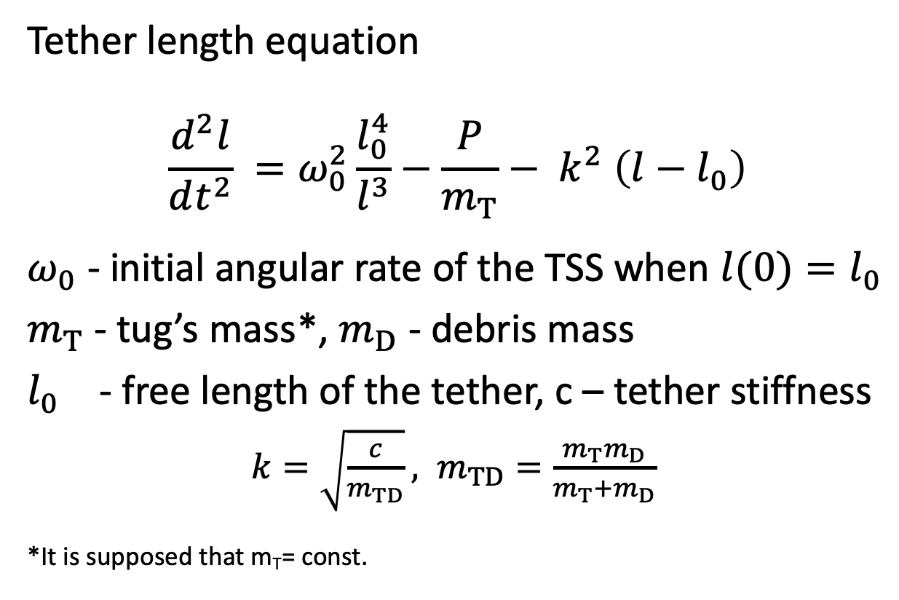
Simple rotating TSS model
Tether length equation
$$\frac{d^{2}l}{dt^{2}} =ω_{0}^{2}\frac{l_{0}^{4}}{l^{3}}−\frac{P}{m_{T}}− k^{2} \left(l−l_{0}\right)$$
$ω_{0}$ - initial angular rate of the TSS when ${l(0)=l}_{0}$
$m_{T}$ - tug’s mass*, $m_{D}$ - debris mass
$l_{0}$ - free length of the tether, c – tether stiffness
$k=\sqrt{\frac{c}{m_{TD}}}, m_{TD}=\frac{m_{T}m_{D}}{m_{T}+m_{D}}$
*It is supposed that m_{T}= const.

Slide 9
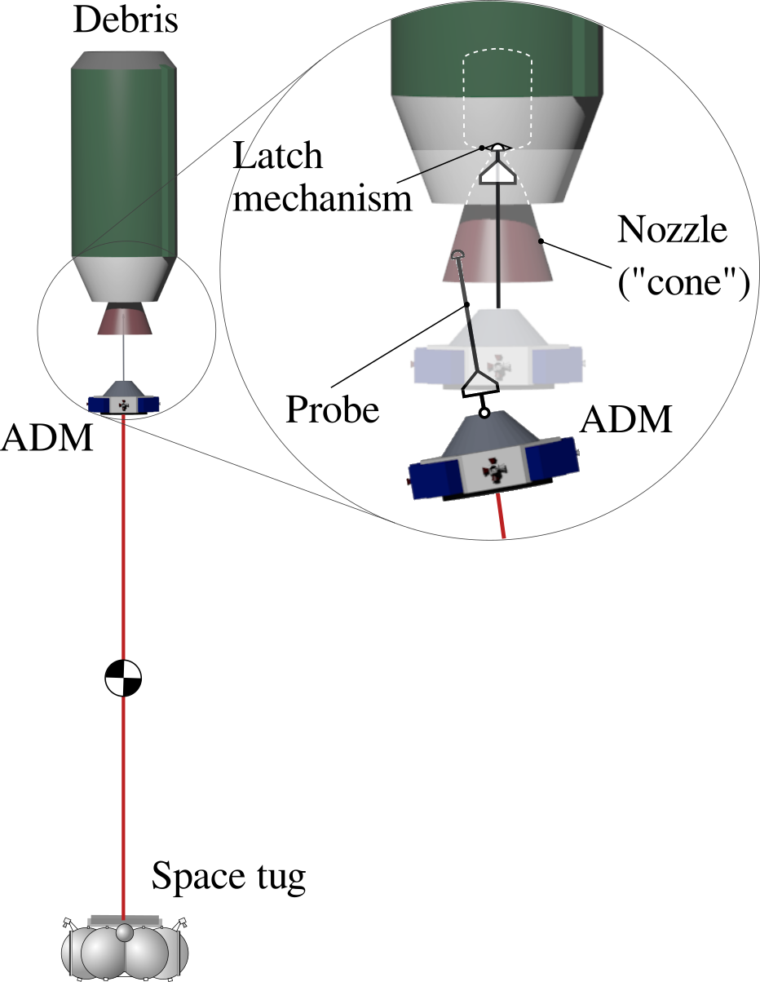
Autonomous Docking Module
Tethered connection between the tug and debris can be established by the Autonomous Docking Module
ADM is a small spacecraft that carries all specific equipment for ADR mission
ADM can use probe-cone* mechanism to dock with the upper-stage-type debris object using the nozzle of the debris as a docking port
*Trushlyakov, V. I., Shatrov, Y. T., Oleynikov, I. I., Makarov, Y. N., and Yutkin, E. A., “The method of docking spacecraft and device for its implementation. Patent RU 2521082.” , 2010.
*Trushlyakov, V. I., and Yudintsev, V. V., “Systems engineering design and optimization of an active debris removal mission of a spent rocket body using piggyback autonomous module,” 3rd IAA Conference on Dynamics and Control of Space Systems (DYCOSS 2017) 30 May - 1st June 2017, Moscow, 2017, pp. 667–681.

Slide 10
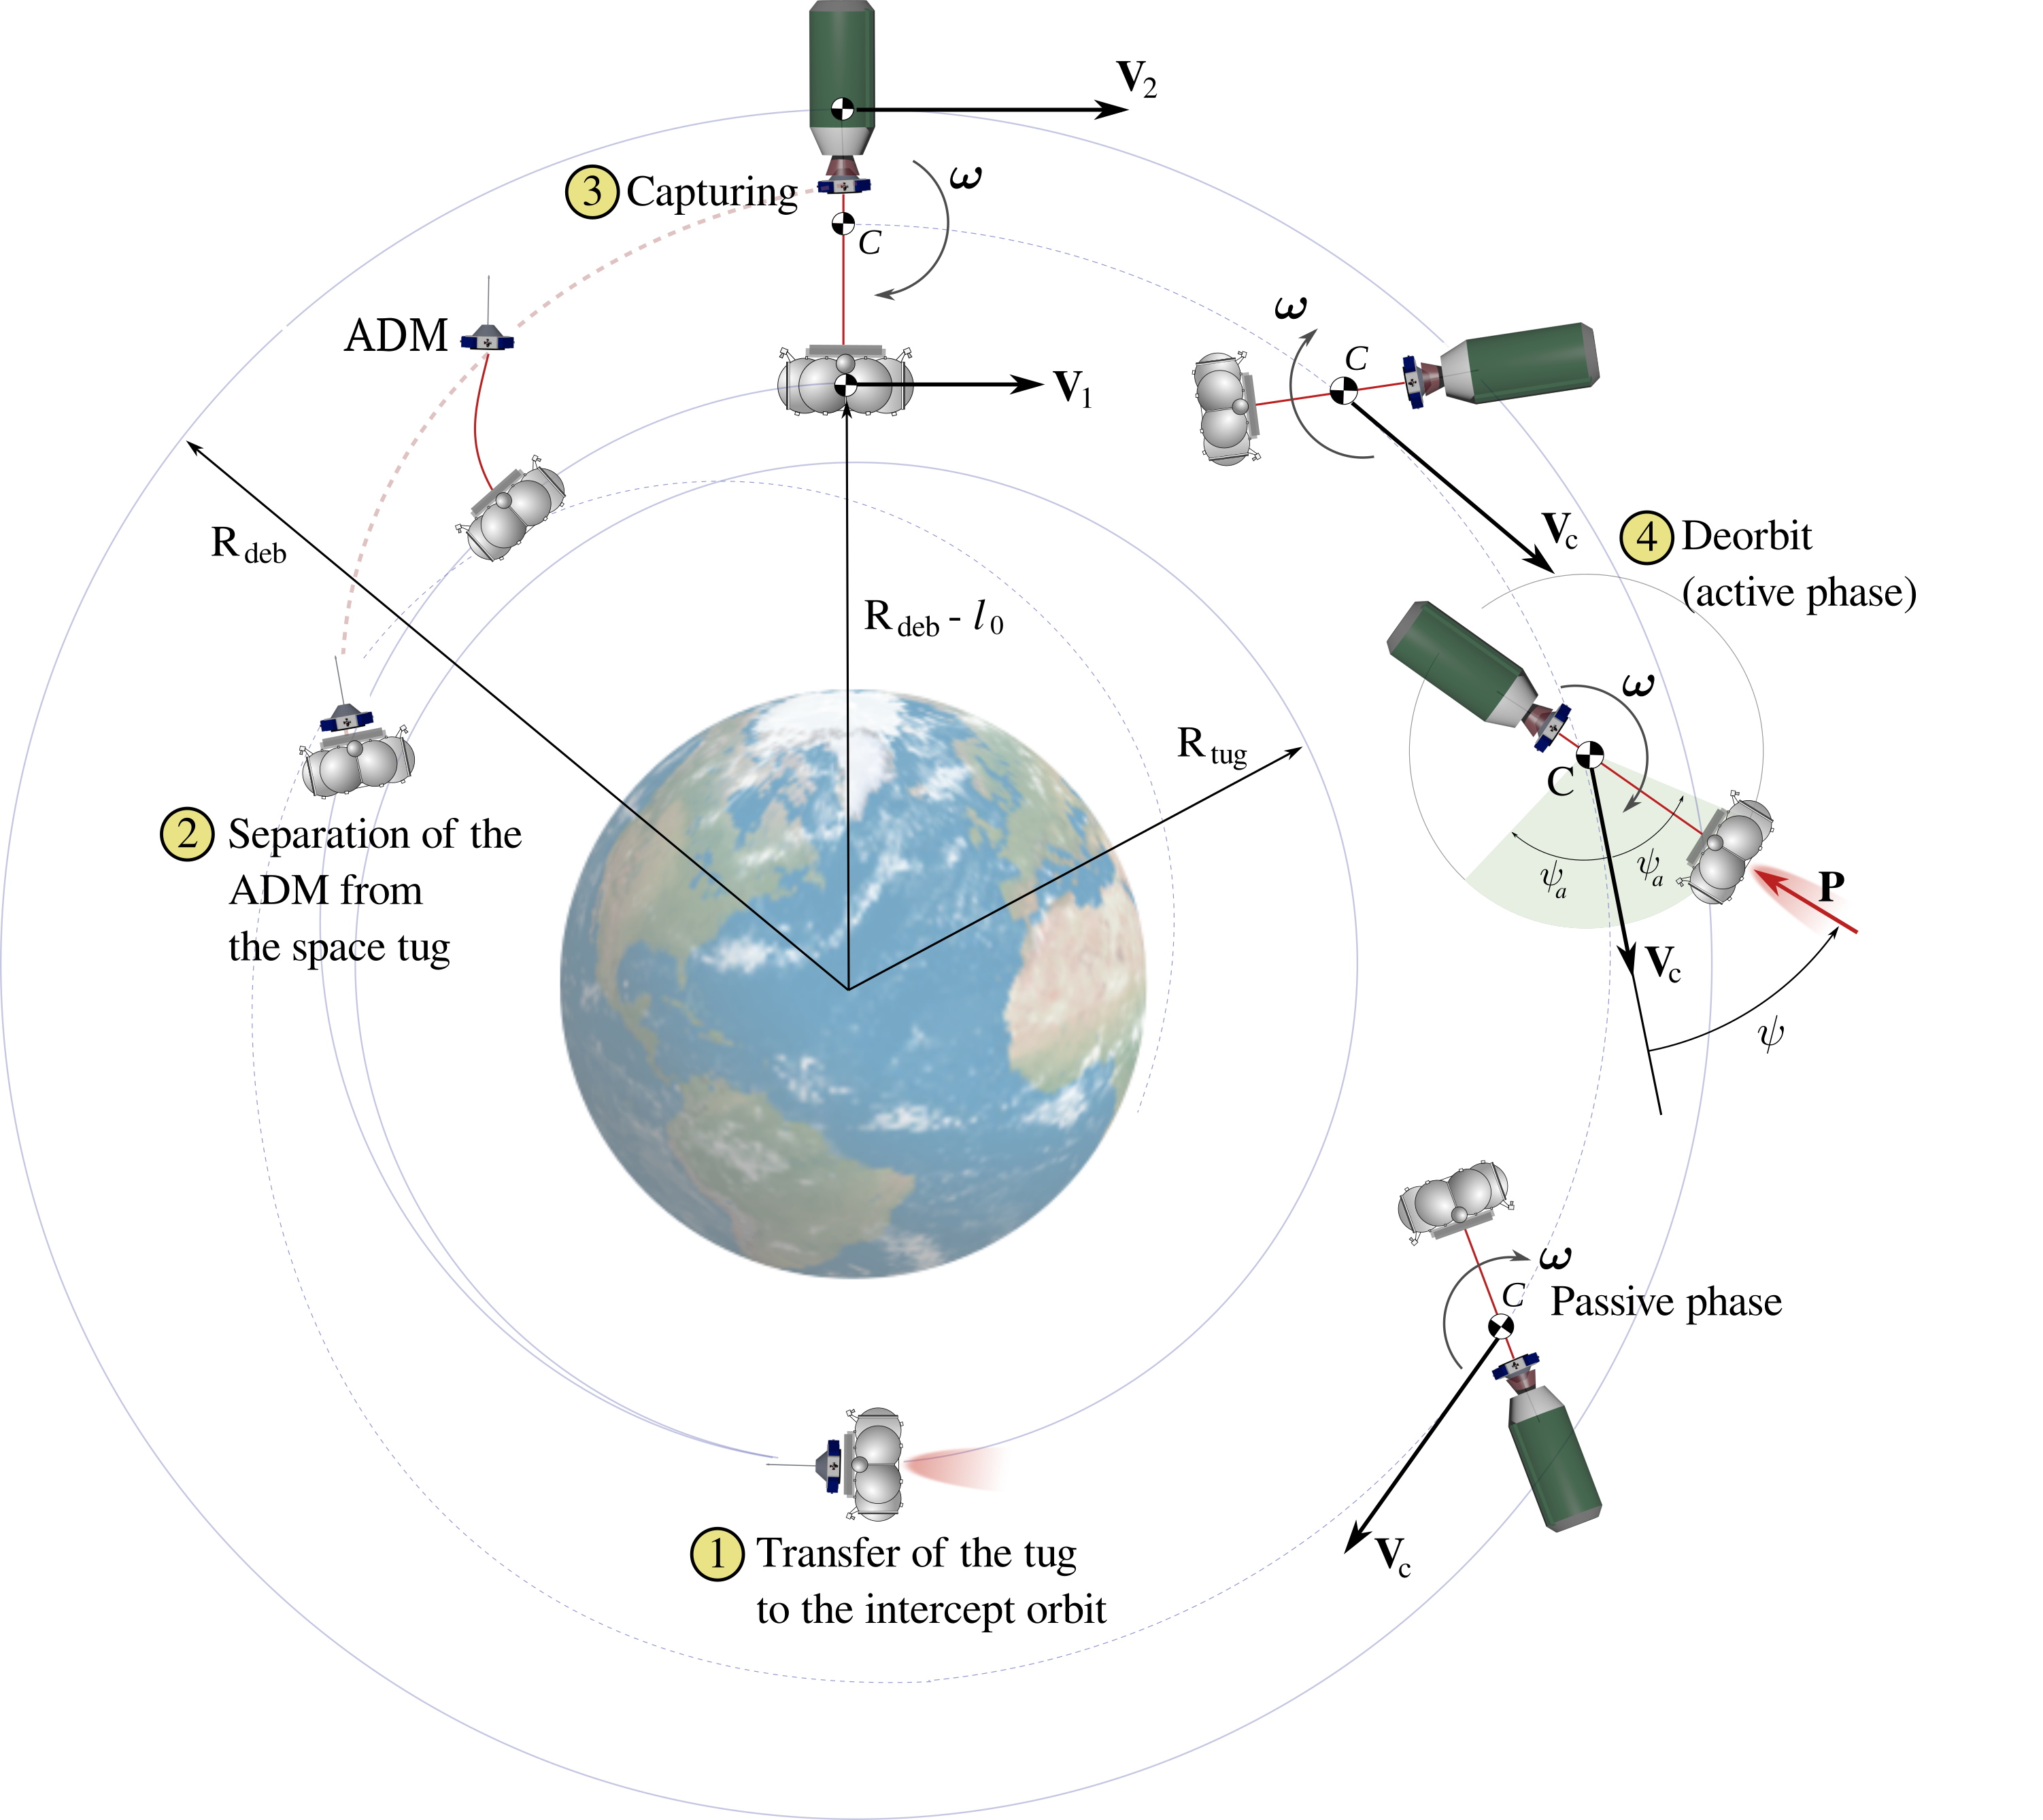
Stages
Transfer of the space tug to the intercept orbit
Separation of the Autonomous Docking Module from the tug
Gripping the debris object
Transfer to a graveyard orbit

Slide 11
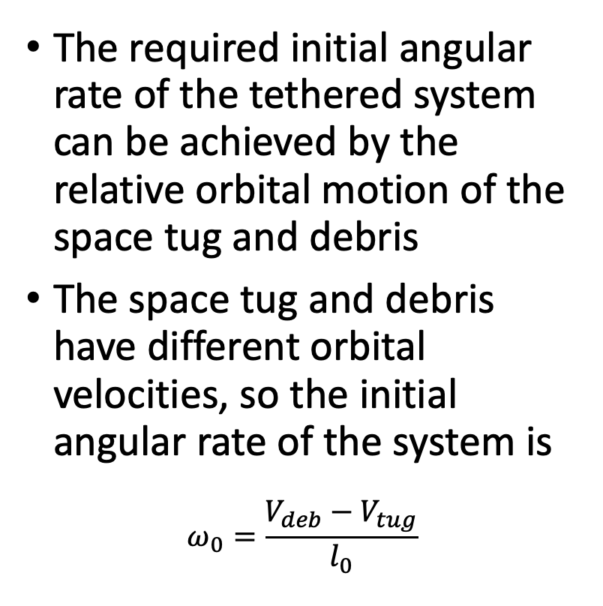
Rotation of the TSS
The required initial angular rate of the tethered system can be achieved by the relative orbital motion of the space tug and debris
The space tug and debris have different orbital velocities, so the initial angular rate of the system is
$$ω_{0}=\frac{V_{deb}−V_{tug}}{l_{0}}$$

Slide 12
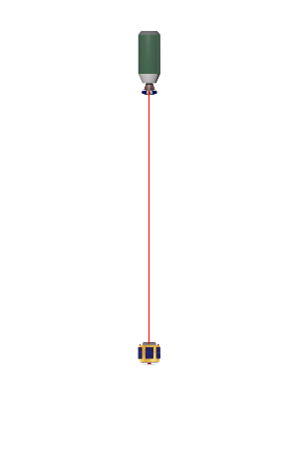
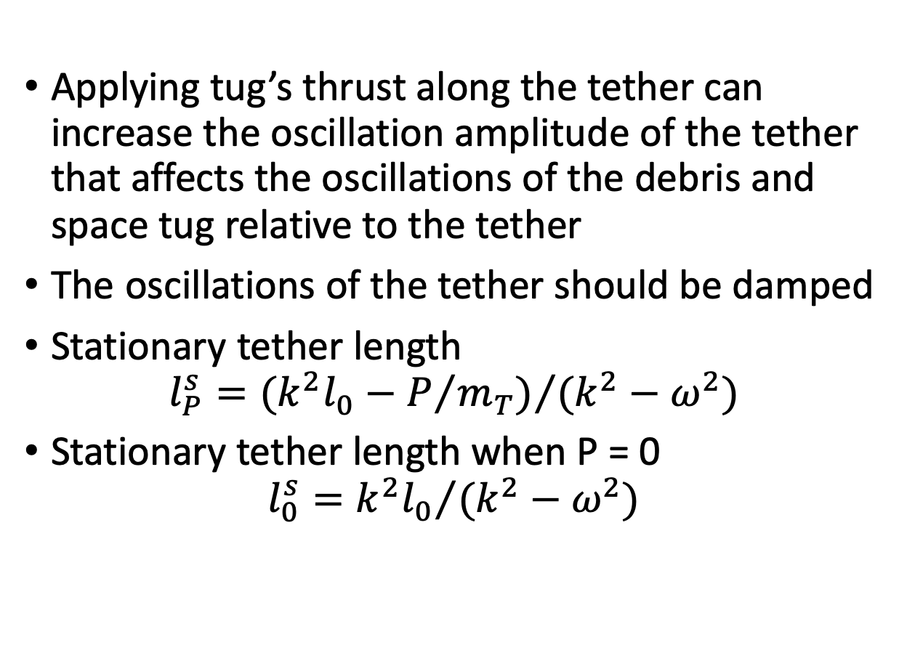
Oscillation damping
Applying tug’s thrust along the tether can increase the oscillation amplitude of the tether that affects the oscillations of the debris and space tug relative to the tether
The oscillations of the tether should be damped
Stationary tether length
$$l_{P}^{s}={(k^{2}l_{0}−P/{m_{T}})}/{(k^{2}−ω^{2})}$$
Stationary tether length when P = 0
$$l_{0}^{s}={k^{2}l_{0}}/{(k^{2}−ω^{2})}$$
*The rotation is not shown

Slide 13
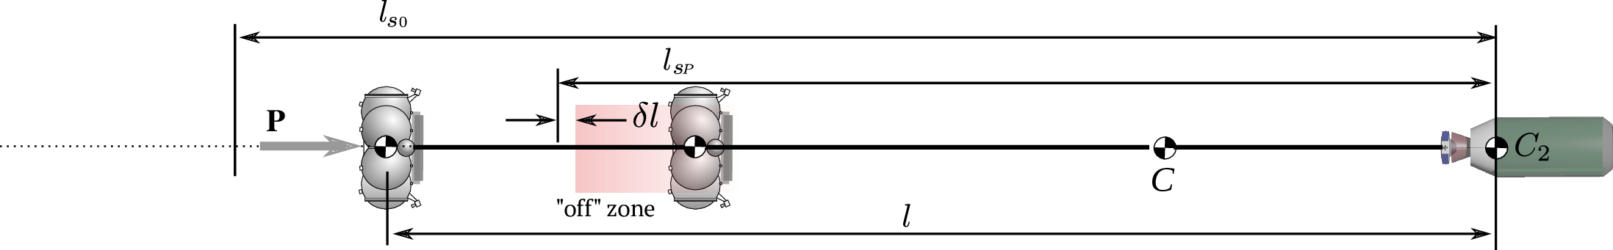
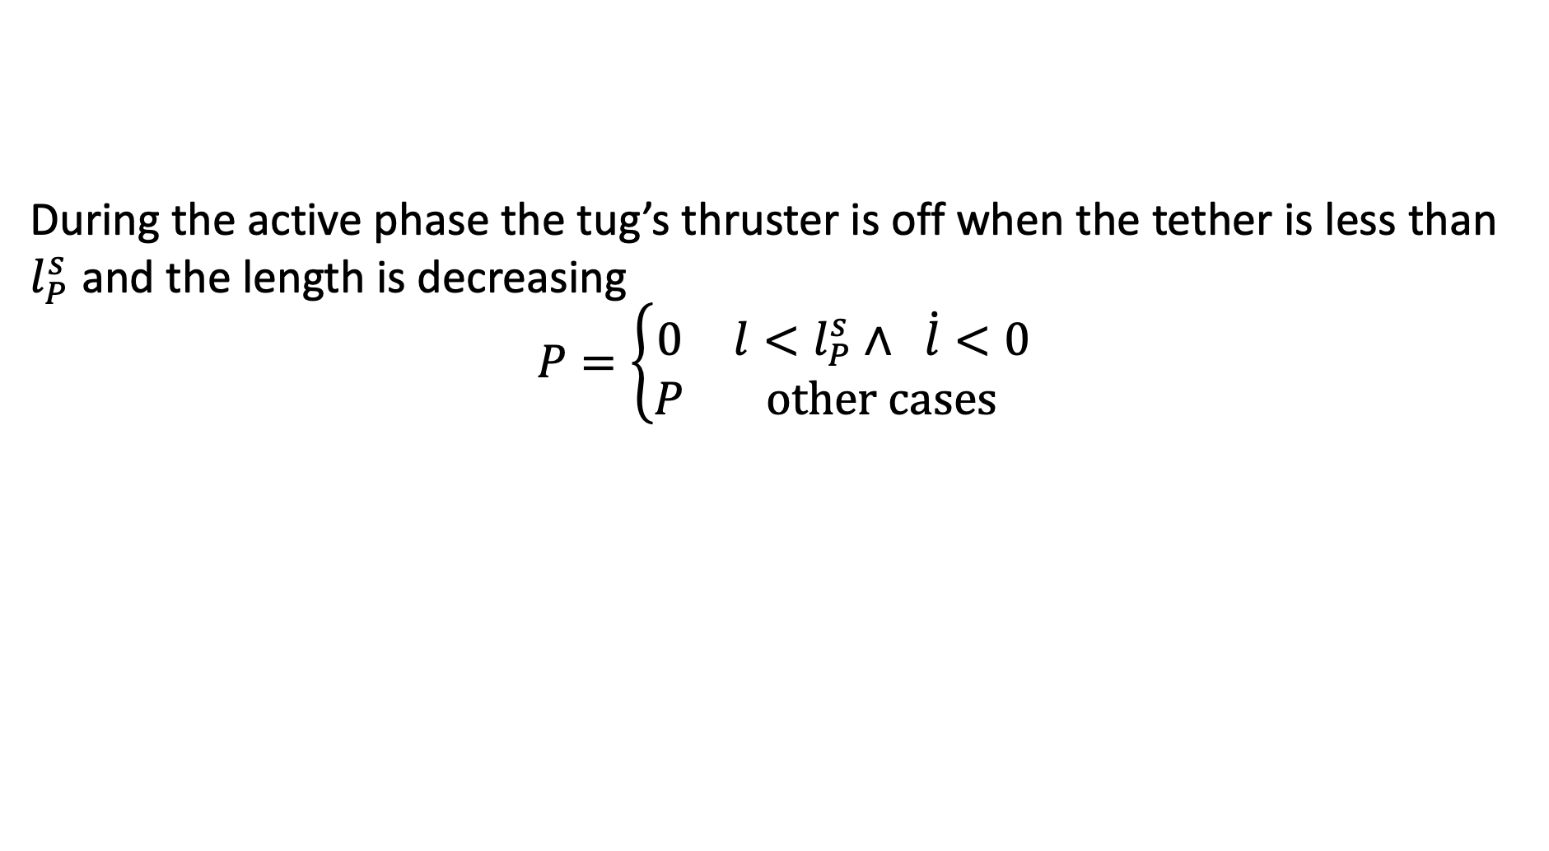
Tether damping
During the active phase the tug’s thruster is off when the tether is less than $l_{P}^{s}$ and the length is decreasing
$$P=\left\{\begin{matrix}0 & l<l_{P}^{s}∧ \dot{l}<0 \\ P & other cases\end{matrix}\right.$$

Slide 14
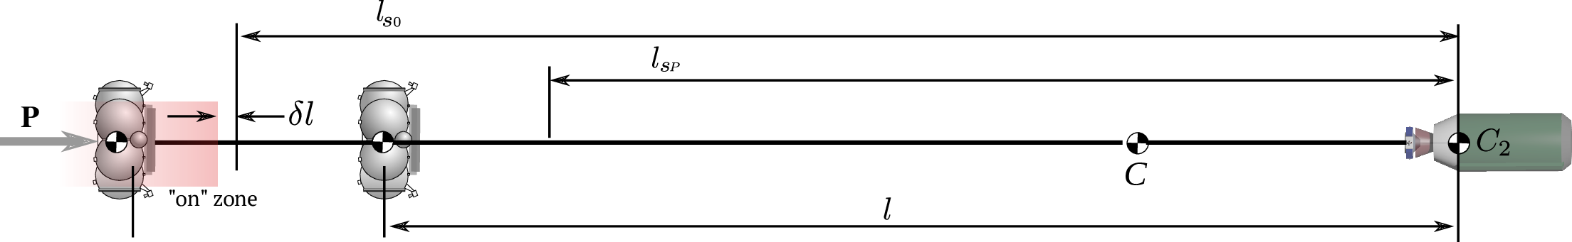
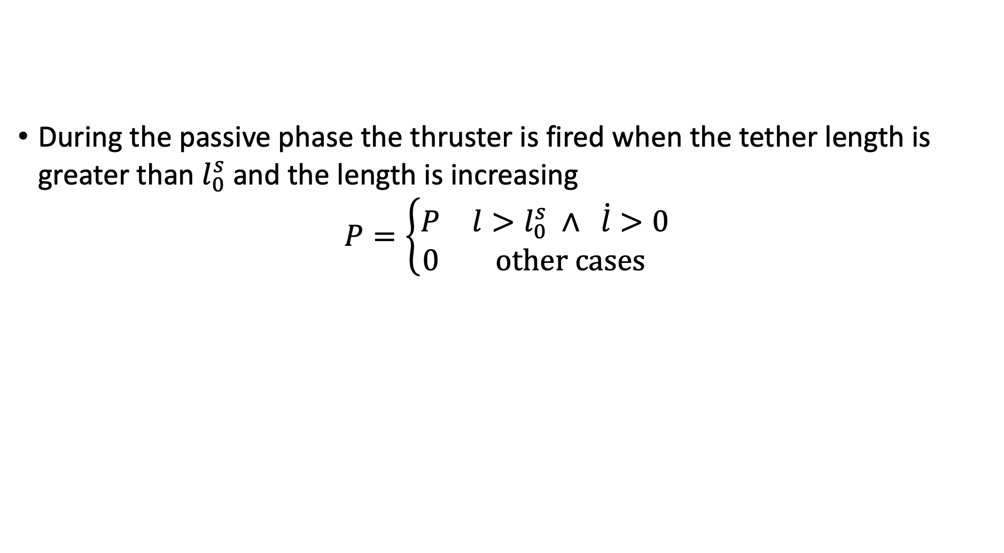
Tether damping
During the passive phase the thruster is fired when the tether length is greater than $l_{0}^{s}$ and the length is increasing
$$P=\left\{\begin{matrix}P & l>l_{0}^{s} ∧ \dot{l}>0 \\ 0 & other cases\end{matrix}\right.$$

Slide 15
Simulation
Parameter | Value
Initial angular rate, deg/s | 1.85
Initial tether length, м | 2000
Space tug mass, kg | 1000
Debris + ADM mass, kg | 1600
Debris orbit, km | 800 x 800
Tug’s thrust, N | 1000
Young's modulus, GPa | 80
Tether diameter, mm | 2
The mass of the debris object includes the ADM mass. The space tug and ADM use simple simple axis attitude control system. The control torque tries to align axis of each body (tug, debris+ADM) with the tether line.

Slide 16
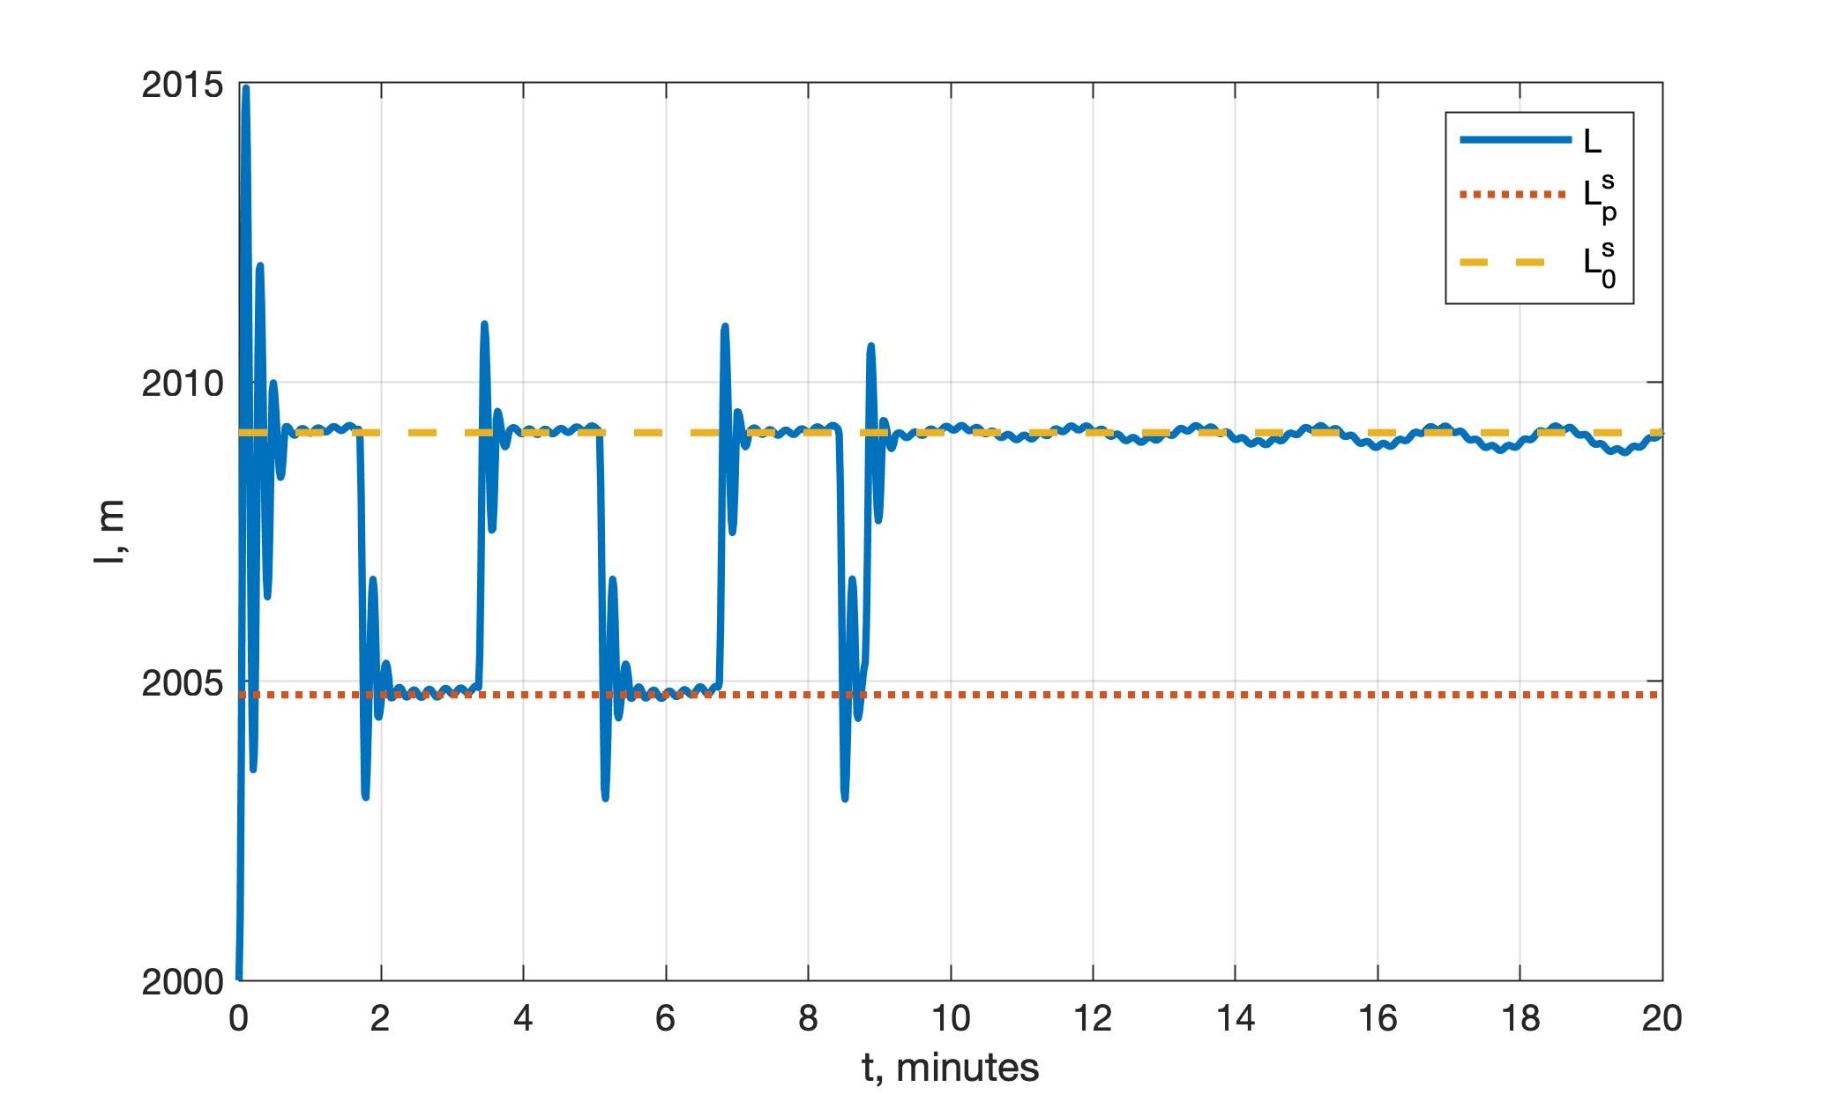
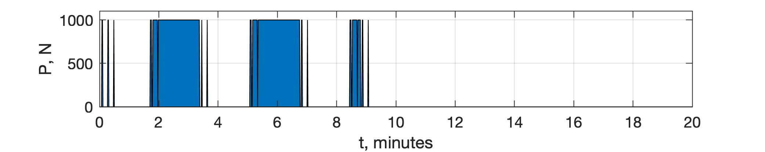
Tether deformation
Tether deformation for the first 20 minutes
Dashed and dotted lines designate stationary tether lengths
Tug’s thruster diagram shows intervals when the tug’s thruster is in “ON” state

Slide 17
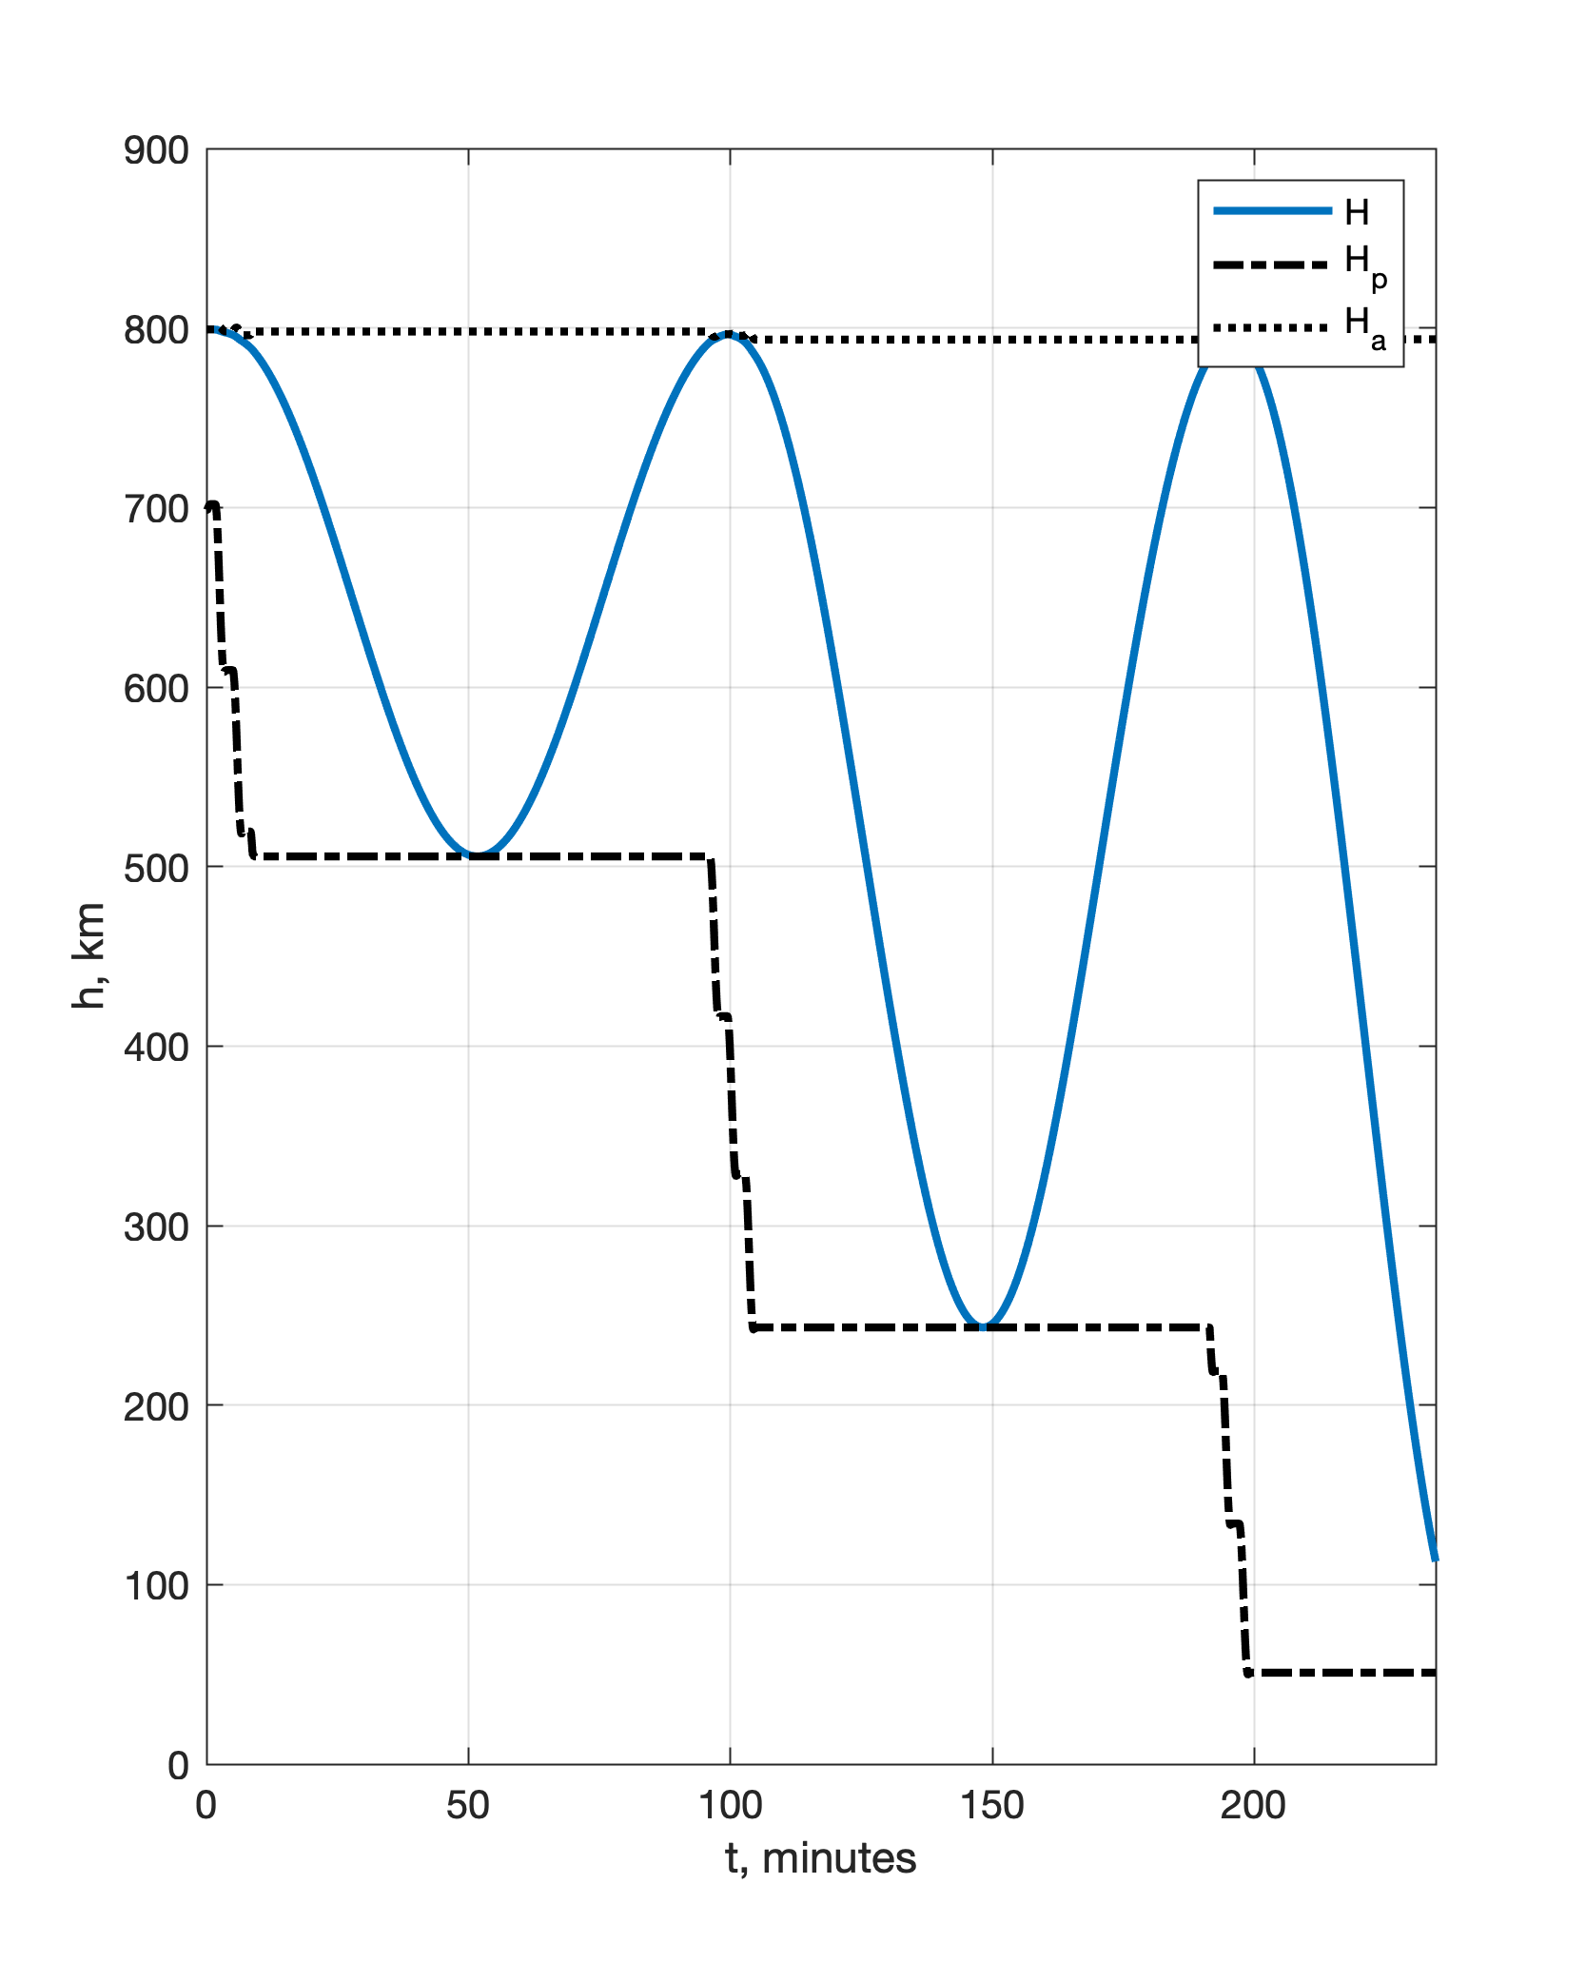
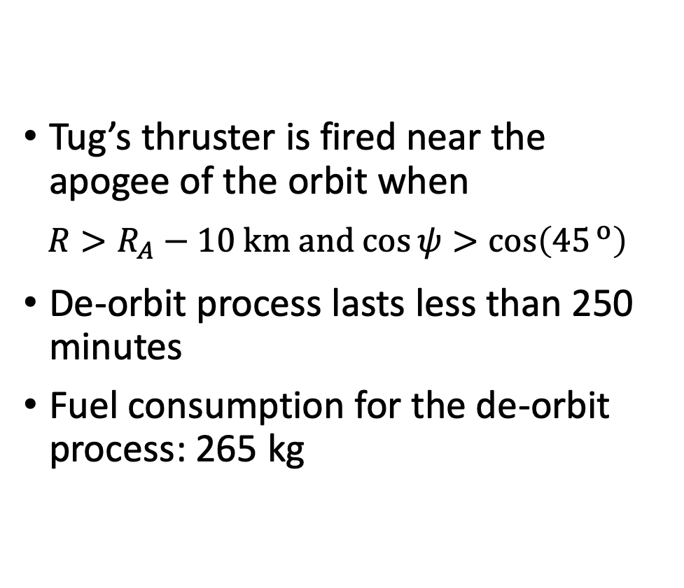
Height of the TSS orbit
Tug’s thruster is fired near the apogee of the orbit when
$$R>R_{A}−10 km and cos{ψ>\cos\left({45}^{ o}\right)} ⁡$$
De-orbit process lasts less than 250 minutes
Fuel consumption for the de-orbit process: 265 kg

Slide 18
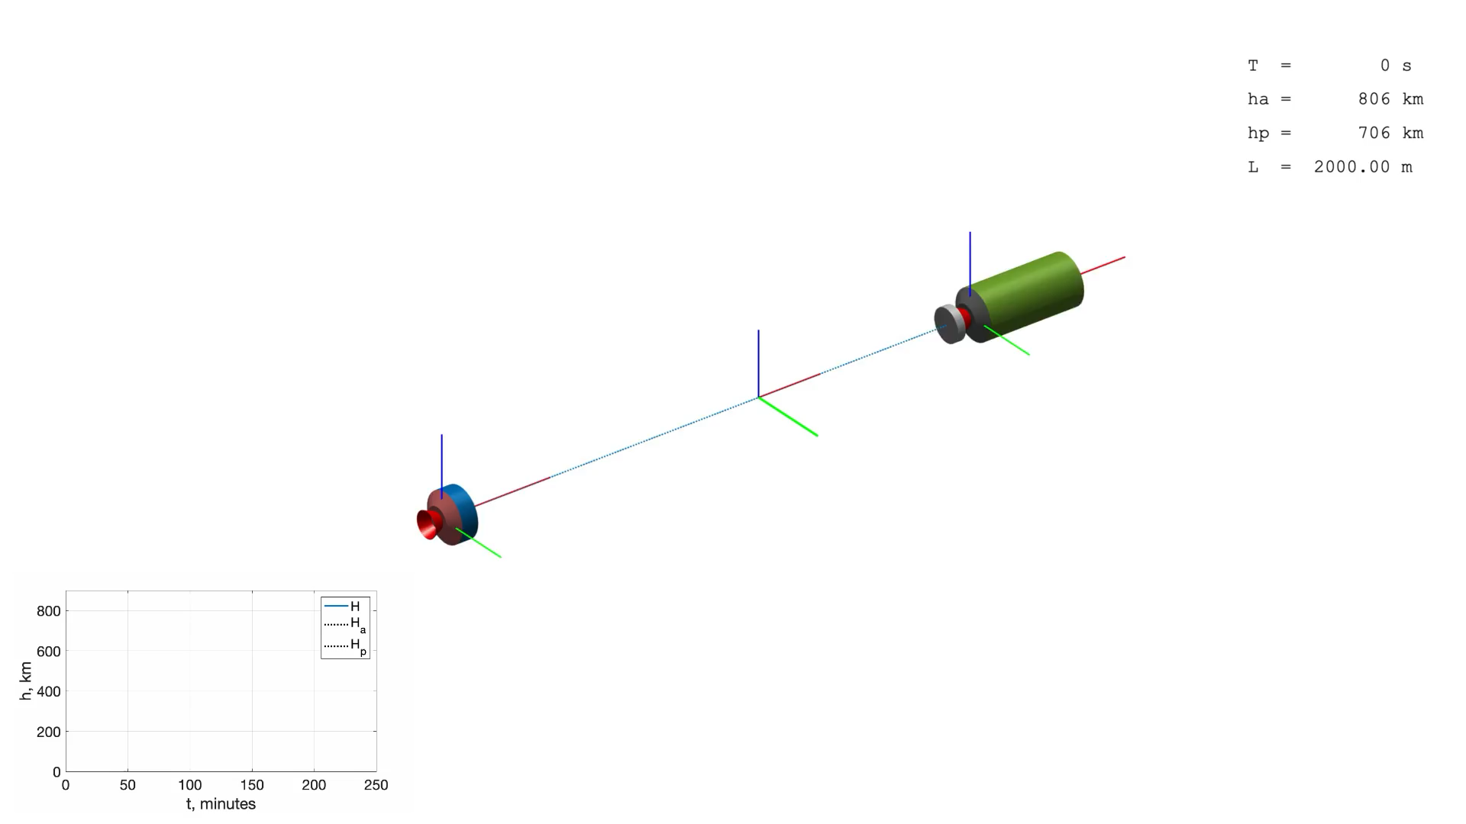
https://youtu.be/SlsS146OirY

Slide 19
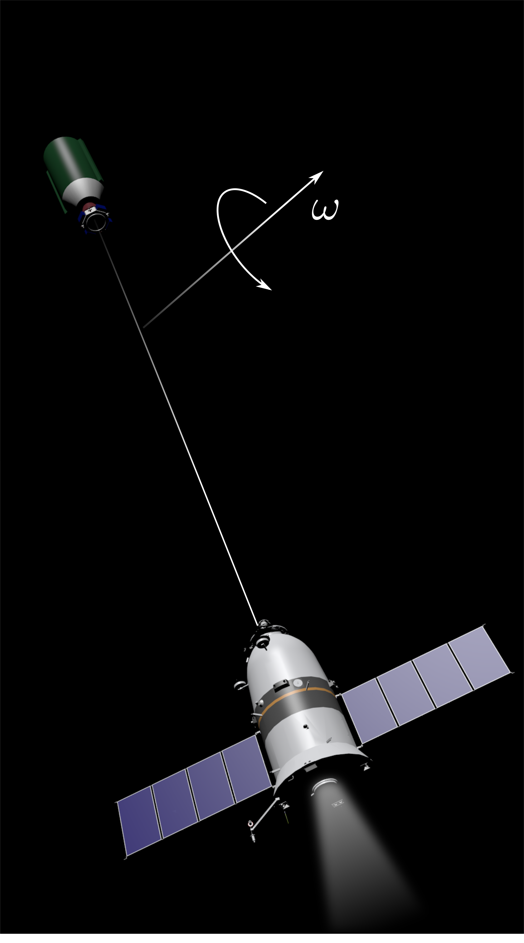
Conclusion
Rotating tethered tug-debris system doesn’t require hard mechanical interface between the tug and debris
Rotating tethered tug-debris system can be used to de-orbit of large debris objects using space tug with conventional design
The space tug can be developed on the base of the existing upper stages or spacecraft (ATV, Briz, Fregat, …)

Slide 20
TO-DO
Proposal for cooperation
Analysis of the gripping process and post-capture dynamics of the tethered tug-debris system using various gripping device installed on the autonomous docking module
Developing attitude control system for the space tug and autonomous docking module (attitude control of the bodies relative to the tether)
Developing a tether length control algorithm to dump the oscillations of the tug and debris bodies relative to the tether

Slide 21
Valery Trushlyakov
Omsk State Technical University
vatrushlyakov@yandex.ru
Vadim Yudintsev
yudintsev@classmech.ru
The First International Orbital Debris Conference (IOC)
December 9–12, 2019, Sugar Land, Texas.

